Slide 1


Library Management System
Project Guide : Team members :
B.Venkat Raman U.Anusha
(Asst.Prof) Rgukt D.Srikanth
B.Jaya Kishore

Slide 2
Overview
The RGULiB (RGUKT Library Management System) is a website designed to provide a comprehensive library management solution for the Central Library of RGUKT, Basar. The System aims to streamline the library operations and enhance the experience for students, faculty and librarians by offering convenient access to book availability information and enabling efficient borrowing and management of library resources.

Slide 3
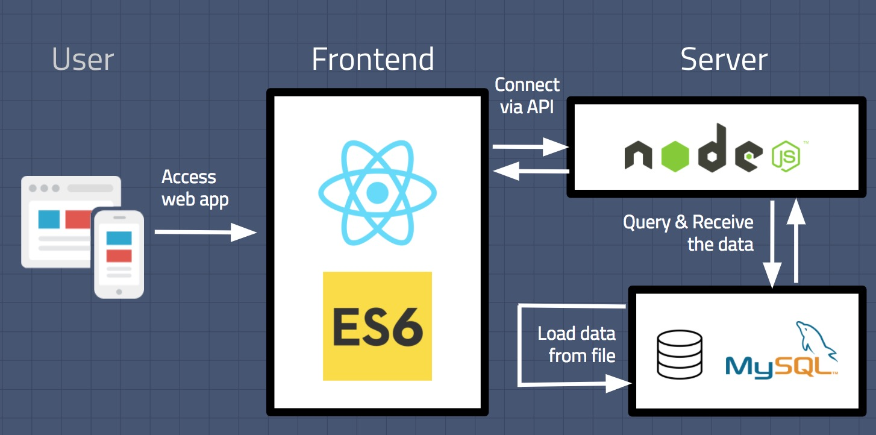
Teck Stack Used

Slide 4
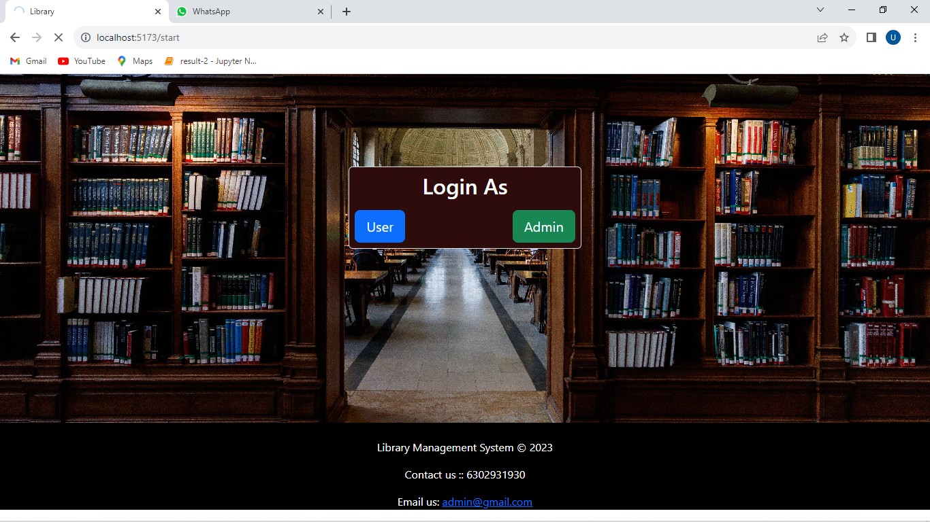
Starting Page of this Website :
It is the first page of the website where it asks whether the person is user or a admin to get access.
This page contains a form which has two buttons
1.Login as user
2.Login as admin
On clicking these buttons it will redirect to the login page of the user, login page of the admin respectively.

Slide 5
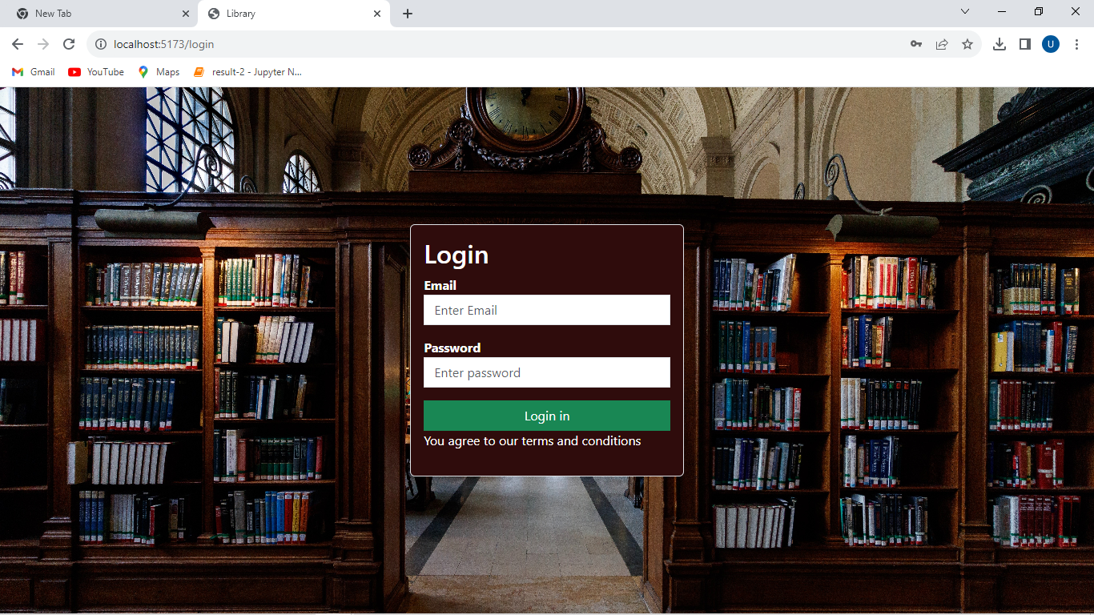
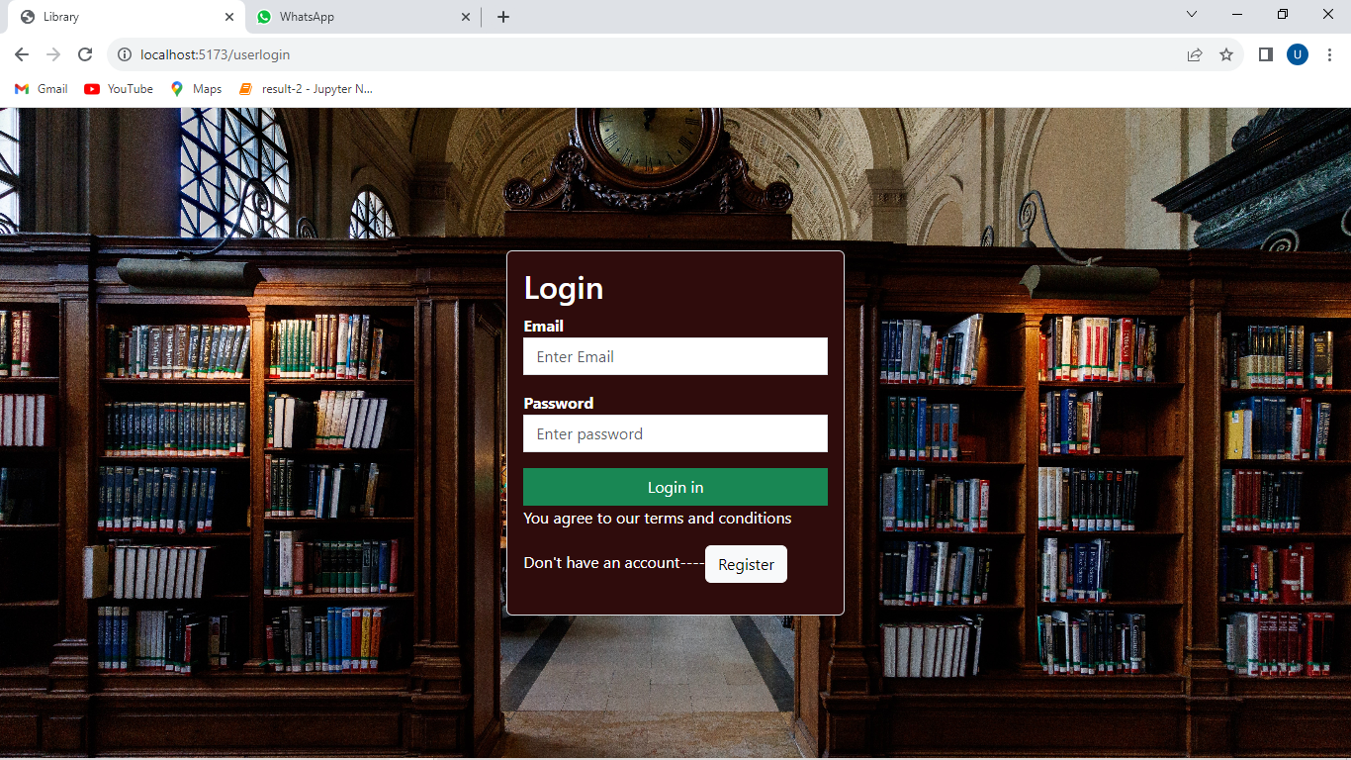
Admin login page
User login page
It has a form which takes admin email and password as input and checks in the database
In-order to provide access to the admin dashboard.
It has a form which takes user email and password as input and checks in the database, in-order to provide access to the User dashboard.
If you don’t have an account it allows you to create account by redirecting to register form on clicking register button.

Slide 6
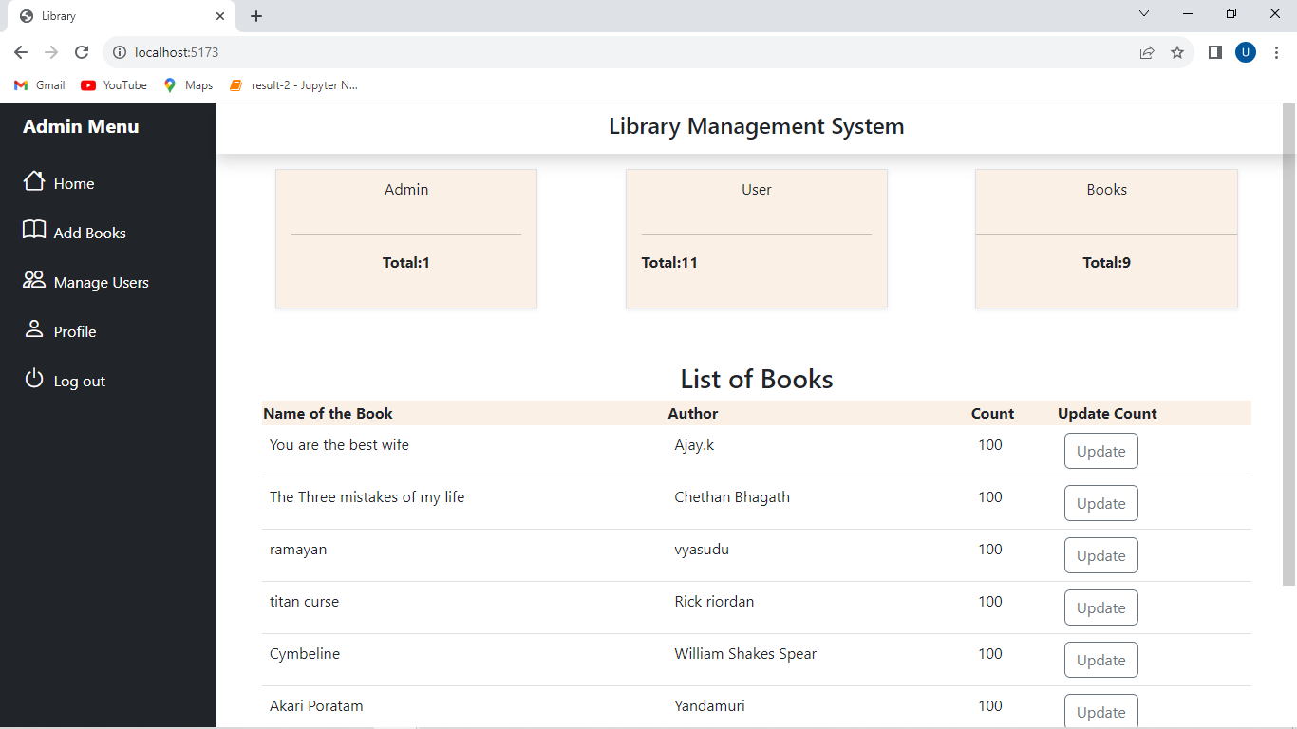
Admin dashboard
Home
User
Add books
Profile
Add
History
update
Update count

Slide 7
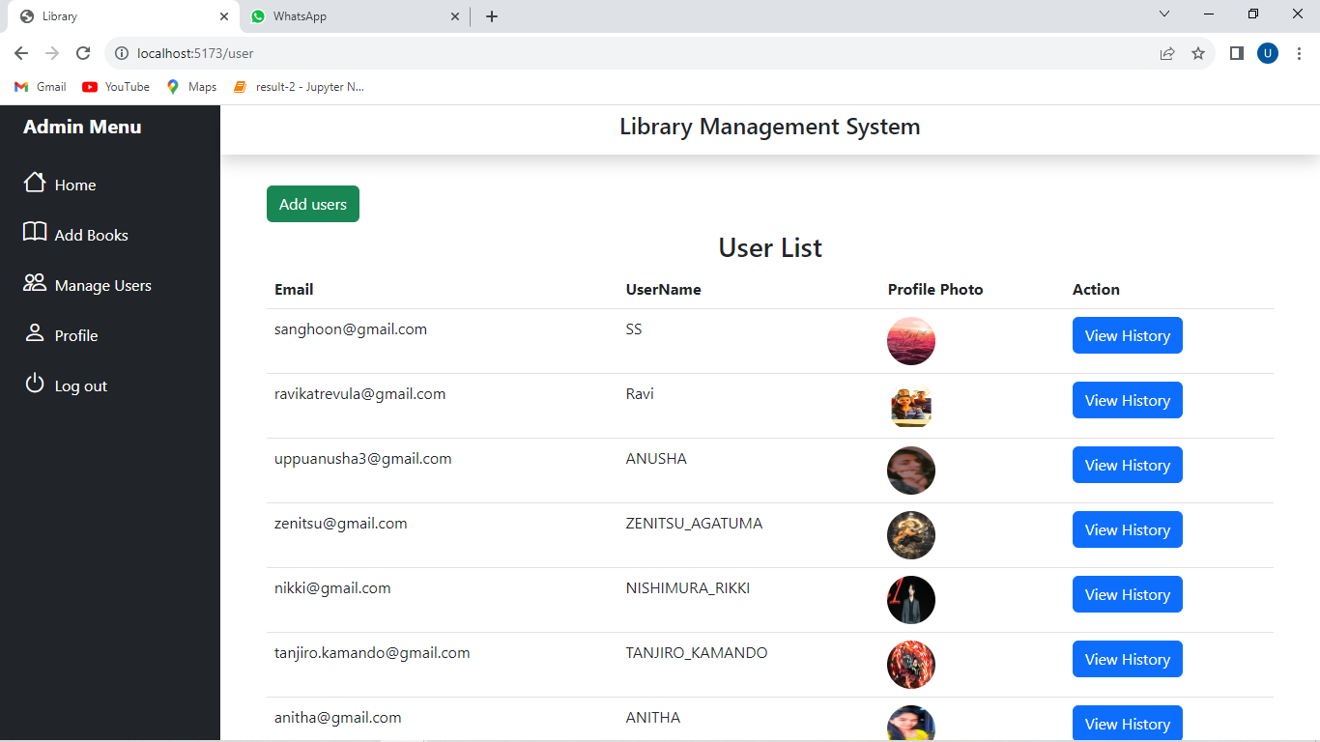
User page
In this page The All the users details will be displayed in the table format and it contains a button add user on clicking this it will redirect to the user registration form.
And view history button also present for every user on clicking this admin see the history of the user.

Slide 8
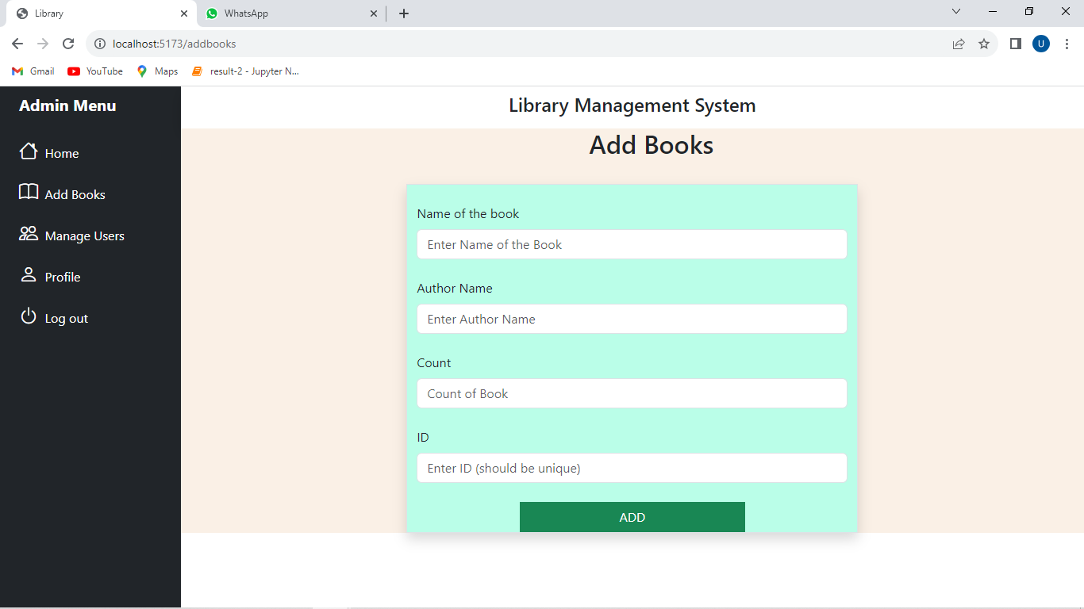
Add Books page
This page contain a form this takes the details of the Book and insert the values in the database

Slide 9
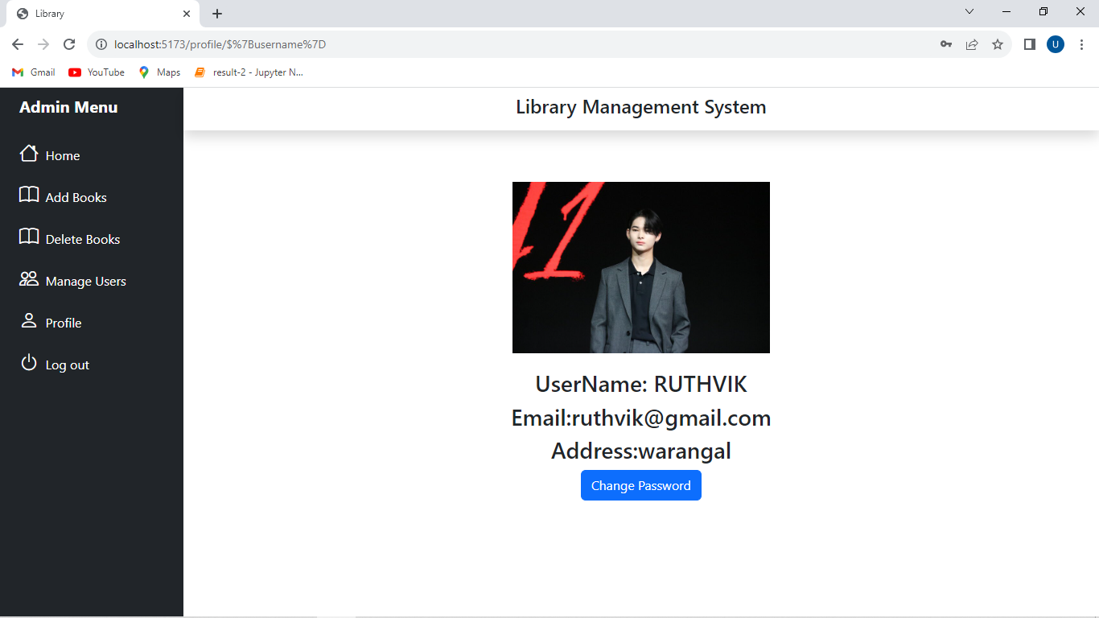
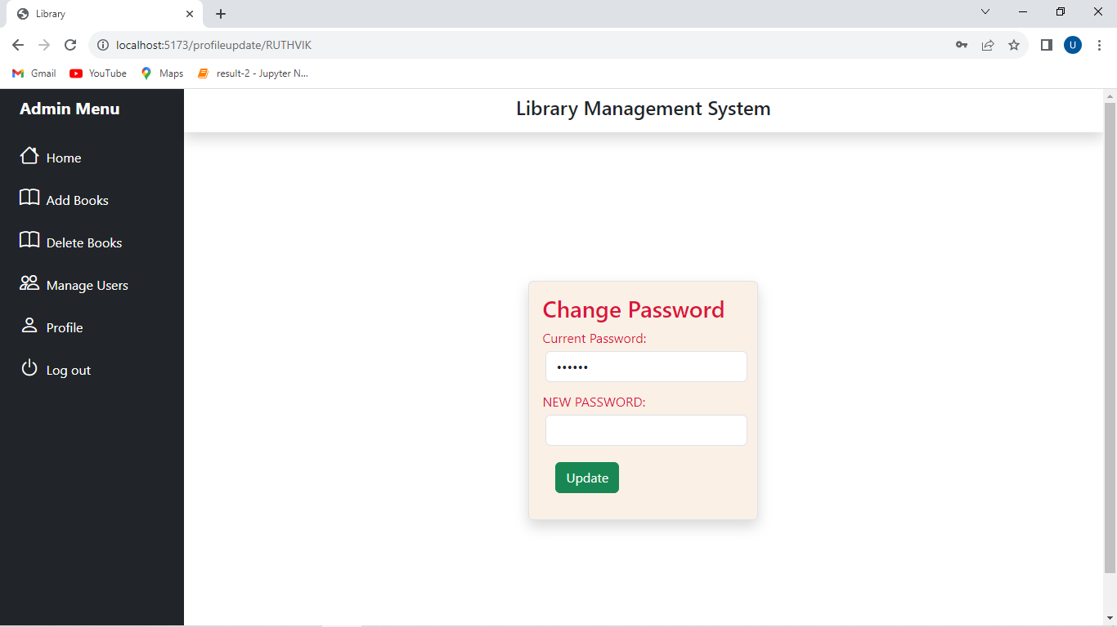
Profile Page
Profile page displays the detail and it the button update password on clicking this will redirect to the update password page it takes the new password and updates it

Slide 10
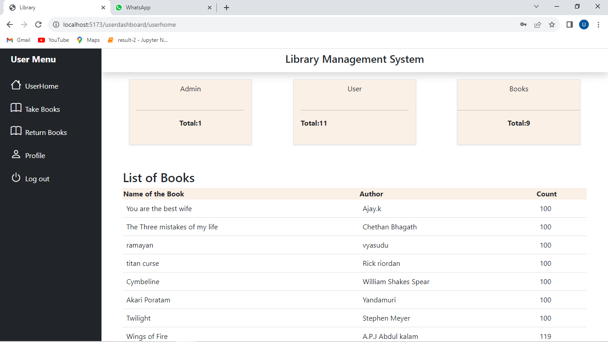
User dashboard
Home
Take Books
Return books
Profile
Borrow

Slide 11
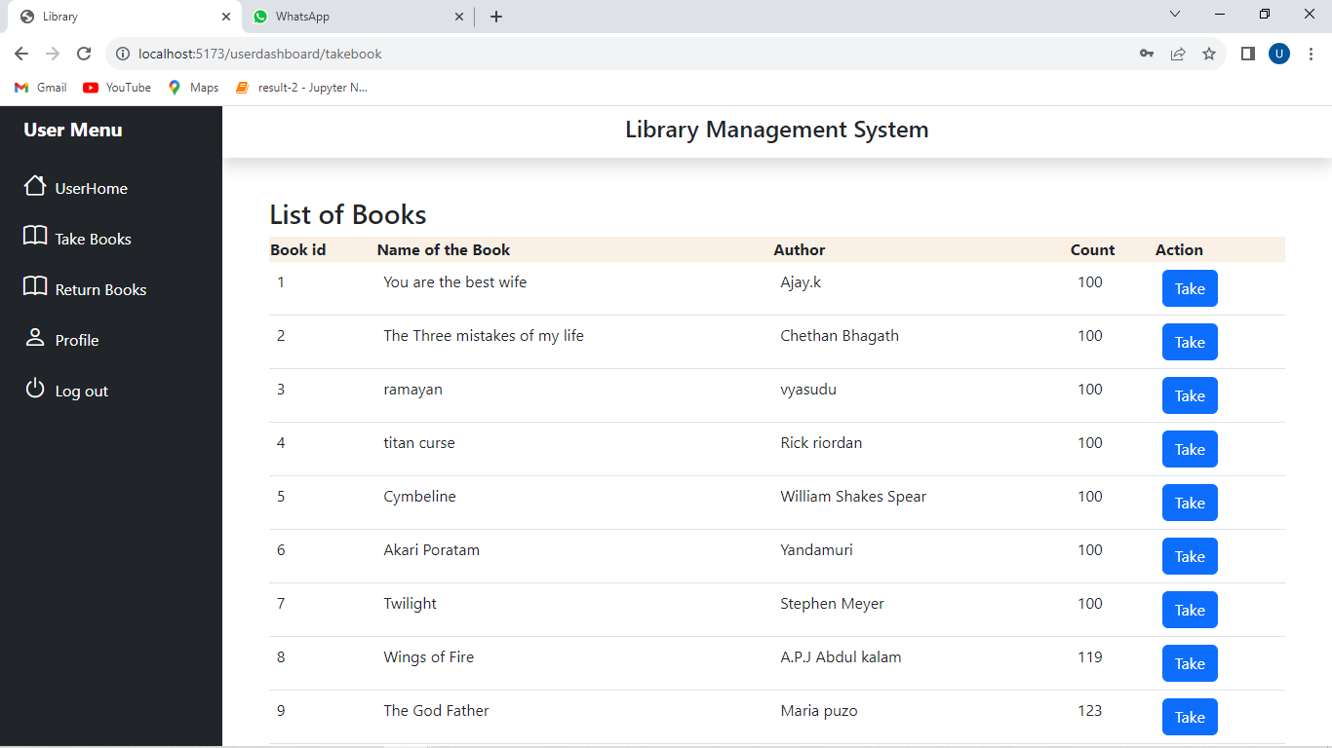
Take Books page
This page shows the all the available books and every books has take button on clicking it will redirect to the borrow page

Slide 12
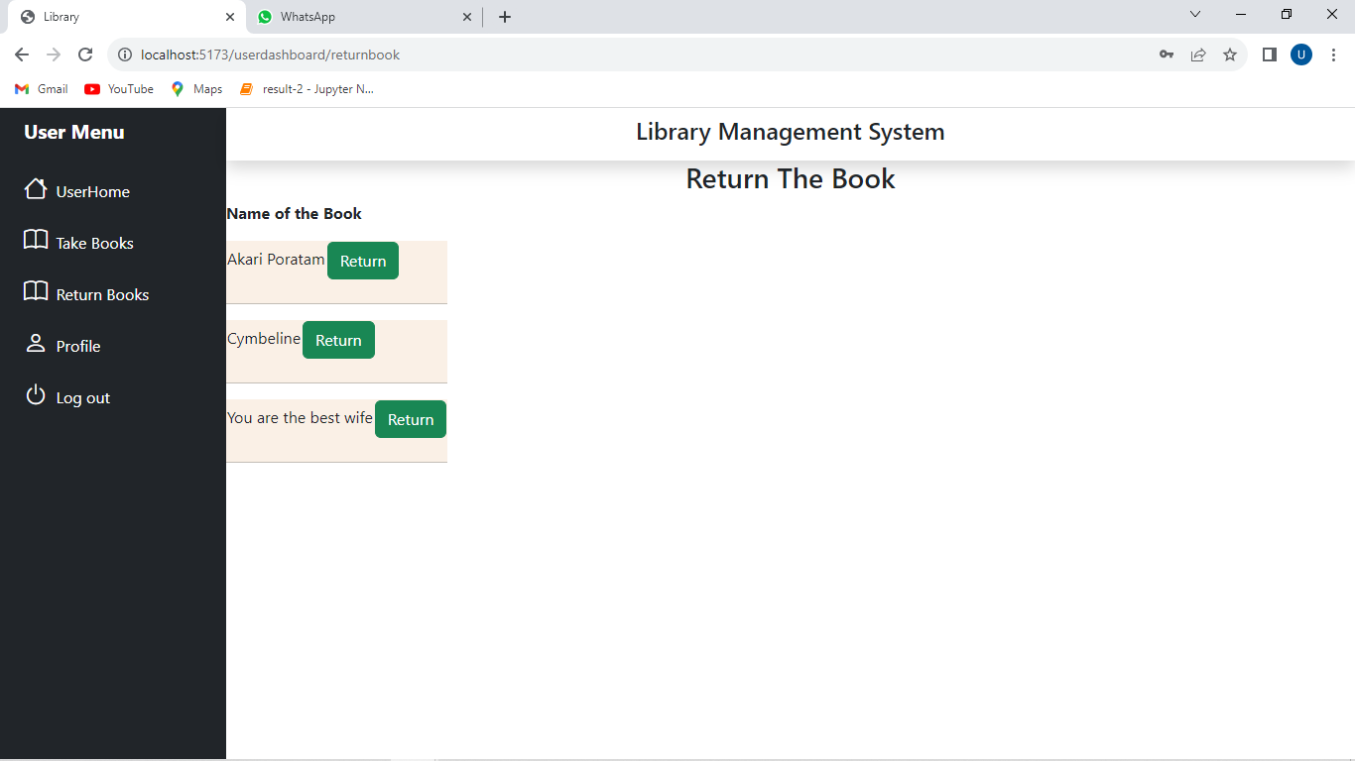
Return Book page
Return books page contains the list of books taken by current user and every book has a return button on clicking he can return the book

Slide 13
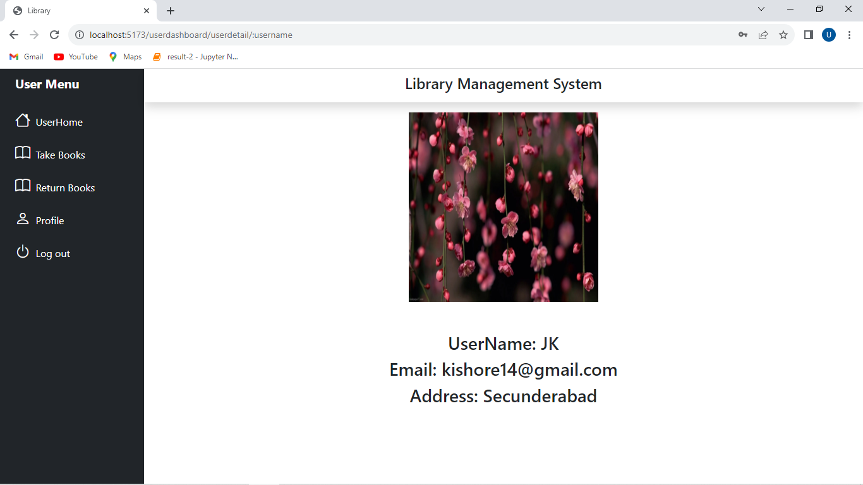
Profile page of User
This page displays the details of The current user who was log in. using username that was taken from the token and all the details are taken from database using username.

Slide 14
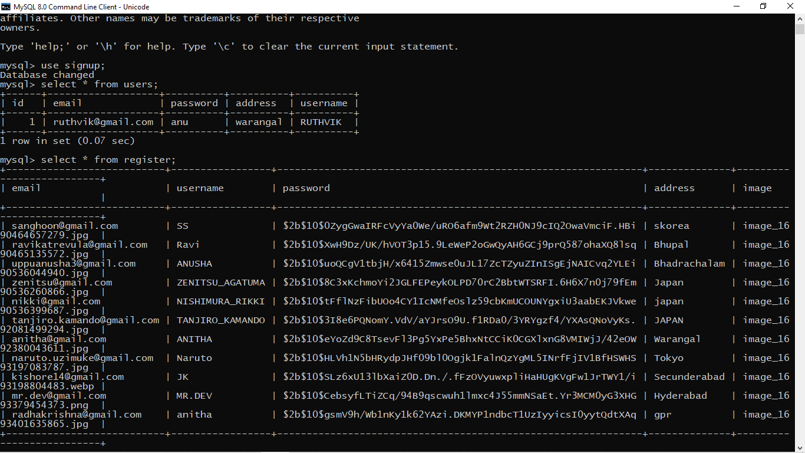
Admins and Users Table in Database

Slide 15
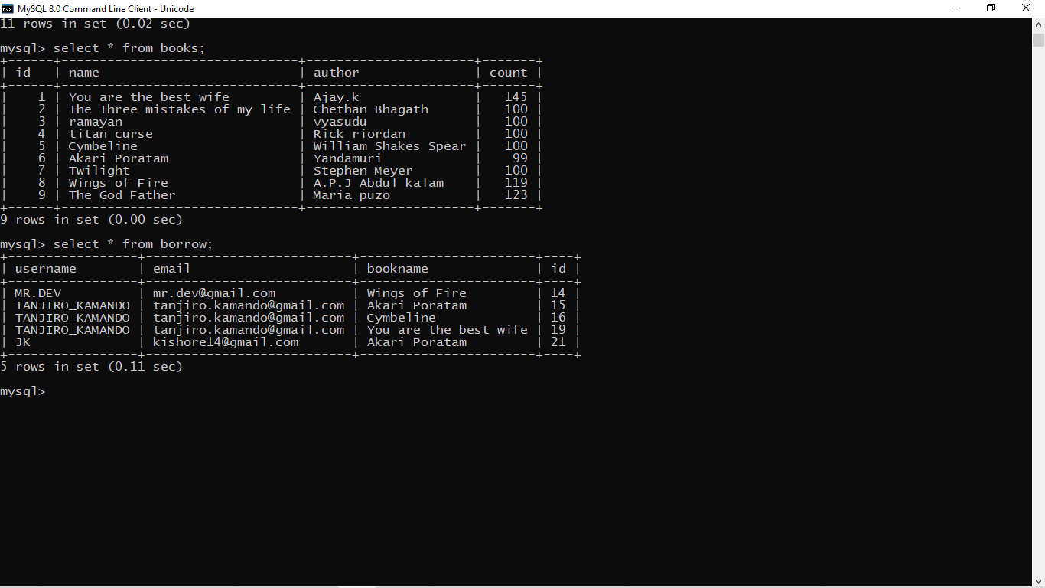
Books and Borrow Tables

Slide 16
ER Diagram of Library Management System
username
email
password
id
Admin

Slide 17
password
Address
Image
username
email
Register(User)
username
email
Take books
id
Bookname
Author
Borrow
id
Book
Bookname
count

Slide 18
Future Scope
In the future, many more features and facilities can be added to the application. As we know with the increase in number of students, books, complexity of other workloads, there can be a need of shifting the library data from the local database to the cloud.
So, this software application can be transferred to a cloud database by doing necessary changes to it. With the help of cloud technology, we will get data backup facility, remotely updating and syncing of files, more security of data, lifetime storage etc.
A group chat function might be included to the app so that students can share their concerns and doubts which will ultimately makes it more interactive and useful for an academic institution.

Slide 19
Conclusion
Our Project mainly focuses on how we can improve the traditional method of working of a library because the traditional method includes doing all the things in manual mode which is slow, less efficient, less secure, and difficult to manage.
The solution to this is an online library management system which take care of all the work by automating and digitizing the whole process. Our application is based on JavaScript and is linked to a relational database (MySQL).
The frontend part has been coded using React.js. The backend is supported and connected with database using Node.js and Express.js, its libraries and APIs. With the increase in the workload of the library, new features can be added to the existing application to make it relevant in the future as well.

Slide 20

Any Queries…

Slide 21


